Slide 1
If you’re like me:
you like to watch ALL credits from a videogame you enjoyed playing.
And everytime I see
THIS

Slide 2

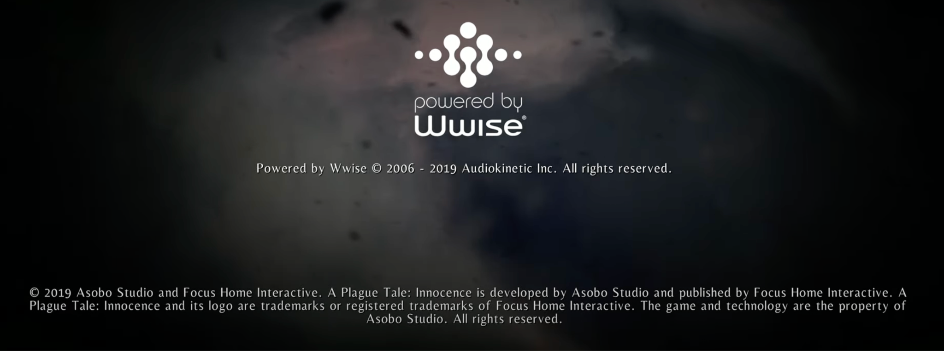
What is this?!

Slide 3
Audio Middlewares
Audio Essentials

Slide 4
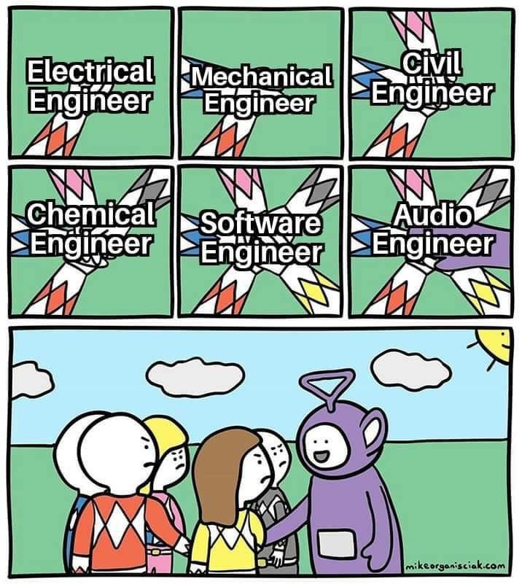
Why we need Middlewares in Audio?
Audio is VERY important in video games
Programming every aspect of audio in video games is very time consuming and tough
Allows musicians (and audio engineers) to focus on that task without the technical details of the software

Slide 5
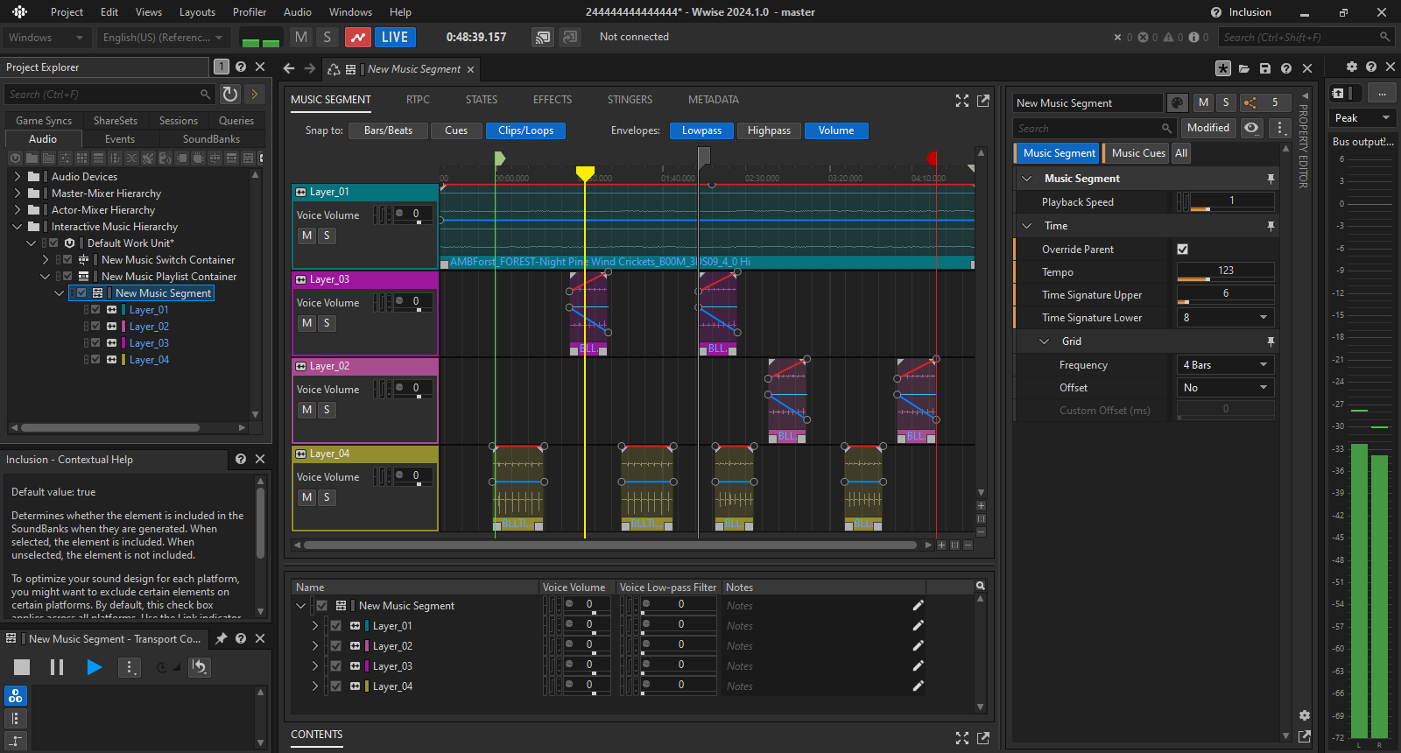
How Audio Middlewares facilitate all of this?

Slide 6
What flow Middlewares use?
Software Engineer Raise event in video game code
Middleware receives that event
Audio Engineer performs audio magic
What gameplay Engineer sees
What audio Engineer sees
Separation of concerns

Slide 7




Games that use WWISE or other Audio Middlewares
Link: https://www.giantbomb.com/wwise/3015-7682/games/

